Slide 1
Cultural Proficiency in Content Literacy tEACHING: Incorporating Background knowledge and Language in teaching English Learners
Dr. Annmarie Jackson
Dr. Cristina WASHELL
GATESOL 2017
mACON, GA

Slide 2
If teachers “see their students’ literacy and language abilities as substandard, they might not design their instruction in a way that target their students’ actual potential”
- Lazar, 2012, p.46
PONDER THIS THOUGHT!

Slide 3
Statement of the problem
Literacy Standards
Immigrant students
Divide
school literacy standards are shaped around the language and experiences of mainstream middleclass families (Lazar, 2012).
skills connected with these standards may not be evident in the literacy practices of students who are not from middleclass homes.
NEWLY ARRIVED IMMIGRANT STUDENTS OFTEN HAVE A SILENT PERIOD.
Teachers may view silence from their immigrant students as ignorance (Heath, 2010).
Teachers still are unsure about how to work effectively with english learners.
there can be a divide between students’ in school and out of school literacy practices.

Slide 4
Perspectives Informing Instruction
Critical Multiculturalism
Cultural Relevant Theory
Critical multiculturalism in theory and practice addresses the inequity and power struggles in education for people within society.
Critical multiculturalism provides opportunities for structural analysis of unequal relationships or institutionalized inequities (May & Sleeter 2010).
May and Sleeter’s (2010) research on critical multiculturalism have informed our stance in instructing our teachers.
The theories emphasize the importance of moving beyond mere multiculturalism to a more critical approach to multiculturalism.
Ladson-Billings (1995) describes cultural competence as the essence of retaining cultural integrity along with academic success.
cultural competence CAN BE ACHIEVED by utilizing students’ culture as a bridge TO connect students’ out of school experiences with their in-school instruction.

Slide 5
Perspectives Informing Instruction
CULTURALLY RESPONSIVE TEACHING
CuLTURALLY RESPONSIVE methods provide teachers with the critical understanding of how students’ cultural, linguistic, and racial identities develop and impact learning (AU, 2011).
Culturally responsive teaching practices include collaborative teaching, responsive feedback, modeling, and instructional scaffolding (Gay, 2000).
Teachers who utilize CRT practices value students’ cultural and linguistic resources and view this knowledge as capital to build upon rather than as a barrier to learning (ACEVES & OROSCO, 2014)

Slide 6
Review of Literature
Dong (2014) suggests that if teachers “recognize English language learners’ prior knowledge as an intellectual resource (they) can use that wealth” (p.30).
Heath (1983) advocates for an alignment of students’ in- school and community literacies for school success.
critical analysis of instruction is necessary to garner the alignment and foster a culturally relevant pedagogy (Ladson-Billings, 1995)
Mastery of academic language is the single most important determinant of academic success for ELLS (FRANCIS et AL., 2006)
many teacher education programs struggle to adequately prepare preservice teachers to successfully address the challenges of teaching diverse student populations (BARNES, 2006)

Slide 7
Review of literature
To prepare teacher for our increasingly diverse schools, teacher education programs are endeavoring to finding ways of raising the multicultural awareness and sensitivity of prospective teachers (SLEETER, 2001).
There is a high correlation between educators' sensitivity (attitudes, beliefs, and behaviors toward students of other cultures), knowledge and application of cultural awareness information, and minority students successful academic performance (Larke, 1990).
teacher education program should be designed to adequately prepare preservice teachers to instruct culturally and linguistically diverse students in their classrooms (BARNES, 2006).

Slide 8
Context
PROGRAM
internship
Courses
Students
4 READING COURSES:
READING IN THE CONTENT AREA
rEADING ASSESSMENT
tEACHING READING AND wRITING
cHILDREN’s LITERATURE
EMBEDDed ESOL STANDARDS IN COURSES
16 Senior level students
15 FEMALE/1 MALE
Cohorted
ELE/SPED DUAL CERTIFICATION
READING ENDORSEMENT
PROFESSIONAL DEVELOPMENT COMMUNITY MODEL
2 YEAR PROGRAM
2 yrs internship in PROFESSIOnAL DEVELOPMENT SCHOOLS (PDS)
1700 hrs. FIELD EXPERIENCE
GPSc REQUIREMENT of 1 YR in a DIVERSE SCHOol SETTING

Slide 9
bACKGROUND: Purpose FOR INSTRUCTIONAL CHANGE
preservice teachers have made effortS to usE texts that are connected to students’ cultures AND REVIEWED VOCABULARY TO SUPPORT THEIR LANGUAGE. (that’s all that amounts to differentiating for els).
However, Much more is needed to incorporate cultural relevance in instruction.
It is our hope, our teachers will move beyond mere tolerance to acceptance of student differences (Nieto, 1994) and will understand the importance of incorporating students’ culture in instruction.
Incorporating cultural relevance in their instruction will build cultural Proficiency in the classroom.
Currently, the preservice teachers are all placed in linguistically diverse school settings, thus the urgency for instructional change.

Slide 10
How can preservice teachers Build cultural relevance and Cultural Proficiency in their content teaching?
Prior knowledgE
Language
Dong (2014) advocates using students’ prior knowledge as a way to adopt students’ intellectual resource in instruction.
Lazar (2014) recommends building on the ways students are already using language in their communities and homes to support their learning.

Slide 11
Session Goal
To show how teacher educators can prepare preservice teachers to adopt more cultural relevance in the Content Area course.
To show How Cultural relevance can be woven in the content mapping of the curriculum, planning and implementation of units.
TO SHOW HOW THE SIOP MODEL CAN BE USED TO DEVELOP CULTURALLY RESPOSIVE TEACHING PRACTICES IN PRESERVICE TEACHERS.

Slide 12
Description of Integration of CULTURAL Relevance in Reading in Content Area
Reading in Content Area:
A course which integrates literacy in content teaching such as social studies & science
One of the key assessments is a Text Set Unit Plan, where teachers build a 5 day-unit using text sets related to content topic, integrate reading and writing skills
Through content map analysis, DISCUSS CULTURAL RELEVANCE, and practice using prior knowledge and language ideas to build their unit.

Slide 13
iMPLEMENTATION: Prior knowledge
CULTURAL RELEVANCE
PRACTICE
Content Mapping
Review Reading Strategies: metacognition schema making inference questioning visualizing determining importance IDENTIFY STANDARDS: CONTENT AND ela
Share literature on multiculturalism/ CULTURAL RELEVANCE:
prior kNOWLEDGE/ lANGUAGE
SHOW STUDENTS STRATEGIES FOR IMPLEMENTION
Preservice TeacherS COLLABORATE WITH EACH OTHER ON WAYS THEY WILL INCORPORATE STRATEGEIS WITHIN THEIR UNITS.

Slide 14
Integrating Literacy in Content Area: Standard Analysis/CONTENT MAPPING
Choose a Science or Social Studies Topic:
Choose the appropriate Science or Social Studies Standard:
Determine ELA standard to support Science or Social Studies Standard:
Determine Comprehension strategy/(ies) that aligns with the standards: ex. questioning, determining importance, making connection, visualizing/inference, synthesizing/summarizing

Slide 15
Prior Knowledge: home & school
Home & School Connection:
(1.)Invite Parents to share events or happening from their culture/countries/ communities that tie into events or topic in the content.
(2)Students interview their parents about events, features, Places, or people in their country similar to events, places, Features or people in the U.S. Classroom Instruction:
(3) Build on Students’ prior knowledge through making connections and QUESTIONING.
(4)compare and contrast events from both cultures in helping to make connection to sTUDENTS’ new LEARNING.
(5) Read Aloud (classroom)
Teacher reads aloud legends or stories from students’ culture or multicultural folktales to connect to the content.

Slide 16
Parent interview
questions
Are/were there any _______________________________ in your country? Where? Have you ever seen _______________________? Tell me about it. Tell me about a time when ________________________ What do you know about _____________________________ What did it look like? What did it sound like? How did it smell? How did it feel? How did it taste? Do you have pictures of _________________________?
Are there any stories or legends about _______________________________ in your culture?
Dear Parents, we will be doing a unit on ______________________________. We are preparing our students to make connections to what we will learn. Students are interviewing their parents and asking questions about the topic. Please help to answer questions or share stories about the topic with your child.

Slide 17
Science: Home and School connection: The interview
Exemplar: Students interview their parents: “are there any Mountains (concepts) in MEXICO (country of origin)? Where ARE THEY? WHAT ARE THEIR NAMES?”
“Tell me about a time WHEN YOU WENT TO THE MOUNTAINS IN MEXICO OR IN the u.s.” (country of origin or community) What did it look like? What did it sound like? Do you have pictures? dO YOU KNOW ANY STORIES OR LEGENDS ABOUT mOUNTAINS?
Instruction pre-planning: Have students gather this information the week before a content unit.

Slide 18
Incorporating STUDENTS’ HOME LEARNING (INSTRUCTION planning)
determine Which comprehension instructional strategy/IES YOU WILL use to build on English learners’ Prior knowledge FROM HOME? Why? CONSIDER What objects or realia, VIDEO, VISUALS could be included to build on students’ background knowledge? Why? How will you make the lesson connect to students’ lives?

Slide 19
Building on English Learners’ Prior knowledge using questioning AND MAKING CONNECTION (instruction)
Exemplar:
Making cONNECTIONs/ SCHEMA
organize students’ learning from parents about topic through TEXT connections: text to world, text to self, text to text
Build on English Learners’ background knowledge using Questioning: KWL

Slide 20
Bringing Prior Knowledge in (Instruction)
Exemplar Making connection: invite students to tell what they know about a topic. Students can write each connection on sticky notes. (1) ESL students make “text to world Connection”
“ I know there was a volcano in El Salvador in 19--- (2) Esl students make “Text to Self Connection” “ My mom saw a volcano in her country. There was a lot of dust.”
Purpose: Students will operate as experts about the topics.

Slide 21
Bringing Prior knowledge in instruction
Know
Want to know
Learned
Text to World
Text to Self
Text to Text
Questioning the Known (Bryan, 1998)
Have students question the known information learned from their Parents
This strategy encourages Higher level thinking and inquiry
sTUDENTS COMPARE THEIR LEARNING FROM HOME TO NEW LEARNING IN THE CLASS

Slide 22
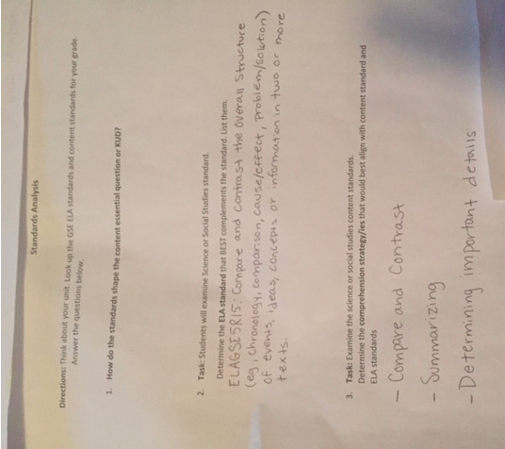

Slide 23
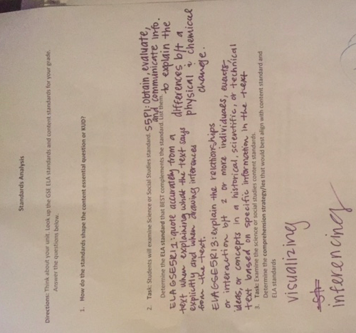

Slide 24
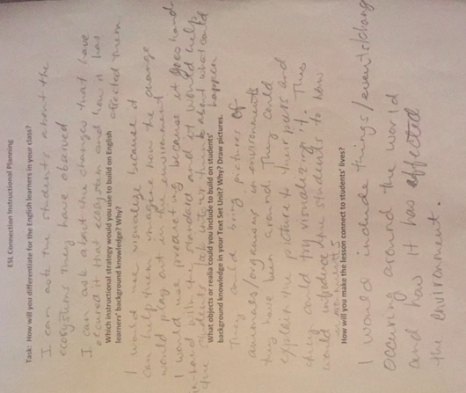

Slide 25
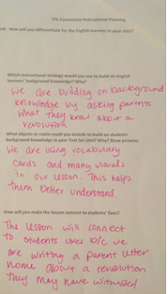

Slide 26
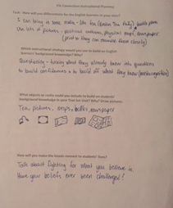

Slide 27
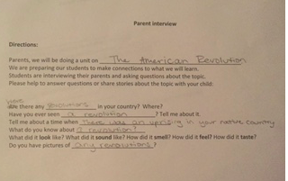

Slide 28
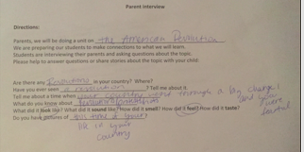

Slide 29
Language in Content Teaching GUIDING PRINCIPLES
crucial application for reading skills is to learn new concepts and develop new knowledge across a range of content areas.
IN order to plan for effective instruction, educators must have a clear understanding of the specific sources of difficulty or weakness for individual students and groups of students.
ELLS often lack the academic language necessary for comprehending and analyzing text.
THE GREAT MAJORITY of ELLs EXPERIENCING READING DIFFICULTIES Struggle with the skills related to fluency, vocabulary, and comprehension.
when planning instruction and intervention, there is a need to consider the function of the instruction.

Slide 30
Incorporating Language in SPED INSTRUCTONAL METHODS COURSE
STUDENTS ARE INTRODUCED TO THE SIOP MODEL BY ADDRESSING THE NEEDS OF ELLS THROUGH A SPED INSTRUCTIONAL METHODS COURSE.
STUDENTS EXAMINE WAYS OF ADDRESSING THE LANGUAGE NEEDS OF ELLS WITH HIGH INCIDENCE DISABILTIES.
STUDENTS HAVE THE OPPORTUNITY TO WRITE LANGUAGE OBJECTIVES FOR VARIOUS CONTENT-SPECIFIC ASSIGNMENTS, E.G. MATH, SPELLING, SOCIAL STUDIES, READING, ETC.
STUDENTS ARE GIVEN OPPORTUNTIIES TO DISCUSS AND DEVELOP WAYS THAT THEY CAN ADDRESS THE LANGUAGE NEEDS OF ELLS IN THEIR SPED FIELD PLACEMENTS.

Slide 31
IMPLEMENTATION: Language
MULTICULTURAL AWARENSS
STUDENT LANGUAGE NEEDS
CULTURALLY RESPONSIVE TEACHING PRACTICES
CONSIDER WAYS OF INCORPORATING CULTURE AND L1 IN TEACHING PRACTICES
DEVELOPING AN INCLUSIVE LEARNING ENVIRONMENT THROUGH THE USE OF INSTRUCTIONAL STRATEGIES
INCLUDE OPPORUTTNIES FOR CULTURAL HERITAGE TO BE INCORPORATED IN THE LEARNING EXPERIENCES
SPED AND LANGUAGE NEEDS
CONTENT OBJECTIVES AND LANGUAGE OBJECTIVES
IDENTIFICATION OF WAYS STUDENTS CAN SUPPORT LANGUAGE DEVELOPMENT IN THEIR ELL/SPED POPULATION IN THEIR FIELD PLACEMENTS
ADDRESS MULTIPLE CONTENT AREAS
INVOLVING ALL STUDENTS IN LEARNING
LESSON MATERIALS AND INSTRUCTIONAL STRATEGIES
LESSON DELIVERY

Slide 32
Language GOALS
MAKING CONTENT COMPREHENsIBLE FOR ALL LEARNERS
DEVELOPING ACADEMIC LANGUAGE AS IT PERTAINS TO SUBJECT
INTEGRATION OF THE EIGHT COMPONENTS OF SIOP MODEL, I.E., LESSON PREPARATION, BUILDING BACKGROUND KNOWLEDGE, COMPREHENSIBLE INPUT, STRATEGIES, INTERACTION, PRACTICE AND APPLCIATION, LESSON DELIVIER, REVIEW AND ASSESSMENT.
IDENTIfication of teaching strategies

Slide 33
IN-CLASS ACTIVITIES
IN-CLASS DISCUSSION OF CURRENT PRACTICES
REVIEW CONTENT DEMANDS AND EXPECTATIONS (STANDARDS)
INDENTIFY CONTENT-SPECIFIC INSTRUCTIONAL MATERIALS THAT ARE MEANINGFUL AND RELELVANT, E.G. REALIA, MANIPULATIVES, VISUALS, ETC.
REVIEW CONTENT-SPECIFIC INSTRUCTIONAL STRATEGIES, E.G. DEMONSTRATIONS, CONTENT-SPECIFIC LITERATURE
ACCESS BACKGROUND KNOWLEDGE AND LINKING NEW MATERIAL TO STUDENTS’ EXPERIENCES AND BACKGROUND, PREVIOUSLY LEARNED MATERIALS, ETC.
WRITE CONTENT OBJECTIVES (OBSERVABLE & MEASURABLE)
WRITE LANGUAGE OBJECTIVES
CONSIDER VOCABULARY DEVELOPMENT, METACOGNITIVE STRATEGIES, ETC.
WRITE INSTRUCTIONAL STRATEGIES THAT ARE ALIGNED WITH CONTENT AND LANGUAGE OBJECTIVES
REFLECT ON FIELD PLACEMENT EXPERIENCES (SKILLS, TECHNIQUES, NECESSARY LEARNING STATETGIES, SCAFFOLDING, ETC.

Slide 34
Stations
participants of the session will engage in the Culturally Relevant Content Mapping of a chosen unit.
After briefly reviewing the standards, participants will select from a menu of language or prior knowledge ideas to build a mini unit.
WRITe CONTENT AND LANGUAGE OBJECTIVES THAT ARE OBSERVABLE AND MEASURABLE
IDENTIFY STRATEGIES TO SUPPORT ACADEMIC LANGAUGE and build on Prior Knowledge.

Slide 35
Language Station: OBJECTIVES and STRAtegIES
IDENTIFY TEACHING STRATEGIES
WRITE LANGUAGE OBJECTIVES
REVIEW STANDARDS
WRITE CONTENT OBJECTIVES
IDENTIFY CONTENT STANDARD
UNWRAPP THE STANDARD
IDENTIFY THE ACTION REQUIRED OF THE LEARNER
IDENTIFY THE CONTENT IN THE STANDARDS
CONTENT OBJECTIVES ARE CLEARLY DEFINED (OBSERVABLE AND MEASURABLE)
DIRECTLY ALIGNED WITH THE CONTENT STANDARD
APPROPRIATE FOR TAGET GRADE LEVEL
WRITTEN FOR STUDENTS TO UNDERSTAND content
focuses on academic language, e.g. content vocabulary, transition words, language function words, and cross-curricular terms
Written using bloom’s taxonomy action verbs
USE HOTS (HIGHER ORdER THINKING SKILLS)
IDENTIFY SIOP TEACHING STRATEGIES
ADDRESSES BOTH CONTENT AND LANGUAGE OBJECTIVES

Slide 36
Prior Knowledge Station
Parent Interview
Dear Parents, We will be doing a unit on ______________________________. We are preparing our students to make connections to what we will learn. Students are interviewing their parents and asking questions about the topic. Please help to answer questions or share stories about the topic with your child.
Questions
Are/were there any _______________________________ in your country? Where? Have you ever seen _______________________? Tell me about it. Tell me about a time when ________________________ What do you know about _____________________________ What did it look like? What did it sound like? How did it smell? How did it feel? How did it taste? Do you have pictures of _________________________?

Slide 37
References
AU, K. (2011). Literacy achievement and diversity. NY: Teachers College PREss
Barnes, C. J. (2006). Preparing preservice teachers to teach in a culturally responsive way. The Negro Educational Review, 57(1-2), 85-100.
Bryan, J. (1998). K.W.W.L.: qUESTIONING THE KNOWN. tHE rEADING tEACHER, 51(7), 618-624.
Dong, Y. R. (2014). The bridge of knowledge: Teachers who recognize English language
learners’ prior knowledge as an intellectual resource can use that wealth. Educational
Leadership, 30-36. Echevarria, J.J., Vogt, M. & Short, D. J. (2008). Making content comprehensible for English learners. The SIOP model. (3rd ed.). Boston, MA: Pearson Inc
GAY, G. (2000). Culturally responsive teaching: Theory, practice, and research. New York: Teachers College Press.
Good, M.E., Masewicz, S. & Vogel, L. (2010). Latino English language learners: Bridging achievement and cultural gaps between schools and families. Journal of Latinos and Education, 9(4), 321-339.
Heath, S. B. (2010). Family literacy or community learning? Some critical questions on
perspective. In Dunsmore. K. & Fisher, D. Bringing Literacy Home. International
Reading Association.

Slide 38
REFERENCES
Heath, S.B. (1983). Ways with words: Language, life and work in communities and classrooms. Cambridge, England: Cambridge University Press.
LADSon-Billings, G. (1994). The dreamkeepers. San francisco, Jossey-BASS Publishing.
Larke, P.J. (1990). Cultural diversity awareness inventory: Assessing the sensitivity of preservice teachers. Action in Teacher Education, 12(3), 23-30.
Lazar (2012). Bridging literacy and equity: The essential guide to social equity
teaching.
May, S. & Sleeter, C.E. (2010). Critical multiculturalism: Theory and praxis. New York: NY: Taylor & Francis.
Nieto, S. (1994). Affirmation, solidarity and critique: Moving beyond tolerance in education. Multicultural Education.
Reese, L. (2012). Storytelling in Mexican homes: Connections between oral and literacy practices. Bilingual Research Journal, 35(3), 277-293.
Ribot, D. (2006). El Santos vs. Tetona Mendoza:Wrestling with Mexico’s experimental comic book narratives. Studies in Latin American Popular Culture, 25, 49-71.

Slide 39
REFERENCES
SLEETER, C.E. (2001). PREPARING TEACHERS FOR CULTURALLY DIVERSE SCHOOLS: RESEARCH AND THE OVERWHELMING PRESENCE OF WHITENESS. JOURNAL OF TEACHER EDUCATION, 52(94).

