Slide 1
2016 TESOL Policy & Advocacy Summit: A Re-delivery
Kendra M. Castelow
Anthony Dahlen
Garlfar Andrews

Slide 2
(Anthony starts with the introduction)

Slide 3
Session Presenters:
Kendra M. Castelow – ESOL Teacher, Houston County Public Schools
Garlfar Andrews – ESOL Teacher, Gwinnett County Public Schools
Anthony Dahlen – Instructor, Chattahoochee Technical College

Slide 4
2016 TESOL ADVOCACY & POLICY SUMMIT
Every Summer
Washington, DC
10 years in-a-row

Slide 5
www.tesol.org

Slide 6
The program featured 2 full days of issue briefings and activities around education legislation and advocacy, followed by a day of visits to Congressional offices on Capitol Hill. With representatives from approximately 30 U.S. affiliates in attendance, the goals of the Summit were not only to learn more about federal policy issues impacting TESOL educators and English learners, but also to provide an interactive learning experience for participants on elements of advocacy.

Slide 7
Sorry…

Slide 8
Summary
The program featured 2 full days of issue briefings and activities around education legislation and advocacy, followed by a day of visits to Congressional offices on Capitol Hill. With representatives from approximately 30 U.S. affiliates in attendance, the goals of the Summit were not only to learn more about federal policy issues impacting TESOL educators and English learners, but also to provide an interactive learning experience for participants on elements of advocacy.

Slide 9
Annual TESOL Summit
When?
19–21 June 2016
Where?
​Minutes from Capitol Hill in Washington, D.C.: Embassy Suites by Hilton Alexandria Old Town 1900 Diagonal Road Alexandria, VA

Slide 10
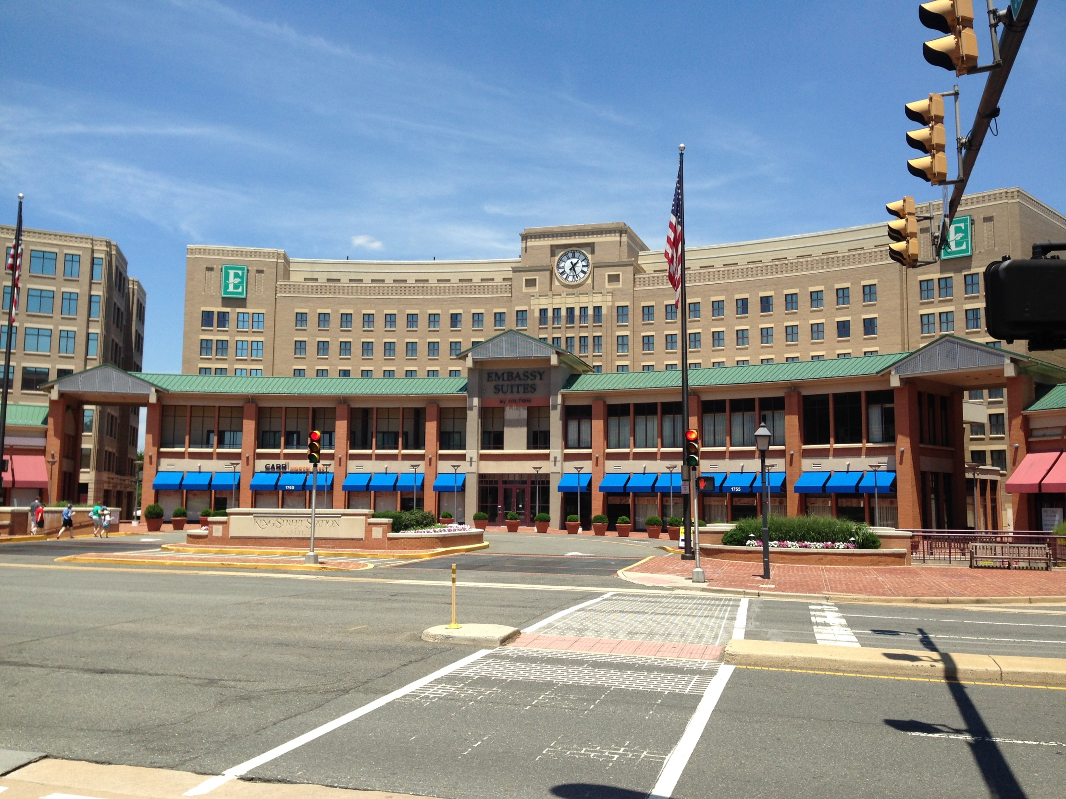

Slide 11
Stats
Over 70 participants
47 states & 3 different countries
14 different sessions
Keynote speakers

Slide 12
Team Georgia!
(Left to Right)
Garlfar Andrews
Kendra M. Castelow
Anthony Dahlen

Slide 13
Schedule
Sunday, 19 June 2016
9:00–10:00 am Registration
10:00-10:30 am Welcome and Introductions
10:30-11:15 am Legislative Overview
11:15-12:00 pm Every Student Succeeds Act and ELLs
12:00–1:30 pm Lunch - Keynote​
2:00–4:00 pm Breakout Sessions
4:00-5:00 pm Closing Keynote - Day 1

Slide 14
Monday, 2​0 June 2016
8:30 am–12:30 pm Speakers and Breakout Sessions
12:30–2:00 pm Networking Lunch
2:00–5:00 pm Grassroots Training and Preparation for Capitol Hill Visits
Tuesday, ​21 June 2016: TESOL Advocacy Day
9:00 am–4:00 pm Capitol Hill Visits
5:30–6:30 pm Closing Dinner and Debrief

Slide 15
Session Information
Update on WIOA & Initiatives by the Office of Career, Technical, & Adult Education-Johan E. Uvin
Luncheon Keynote by Sylvia Acevedo
The Rights of Immigrant Children and English Learner in Public Schools-Roger C. Rosenthal
Addressing WIOA’s Threats to Services for Adult English Learners
Advocating for English Language Learners

Slide 16
Session Information (Cont.)
DACA and DAPA: How Does President Obama’s Executive Action Impact Youth and Families?
ESSA: New Opportunities to Engage TESOL Members
Advocating for the Preparation of All Teachers of ELs: What Teachers Can Do
USDOE, OCR, & Office of English Language Acquisition Policy Updates

Slide 17
Session Information (Cont.)
Engage and Empower: How to Talk and Teach about Immigration
English Language Learners & Common Core State Standards
From Immigration Policy to People
Policy Update from the Student and Visitor Exchange Program

Slide 18
Workshop in progress

Slide 21
Workshop selfie

Slide 22
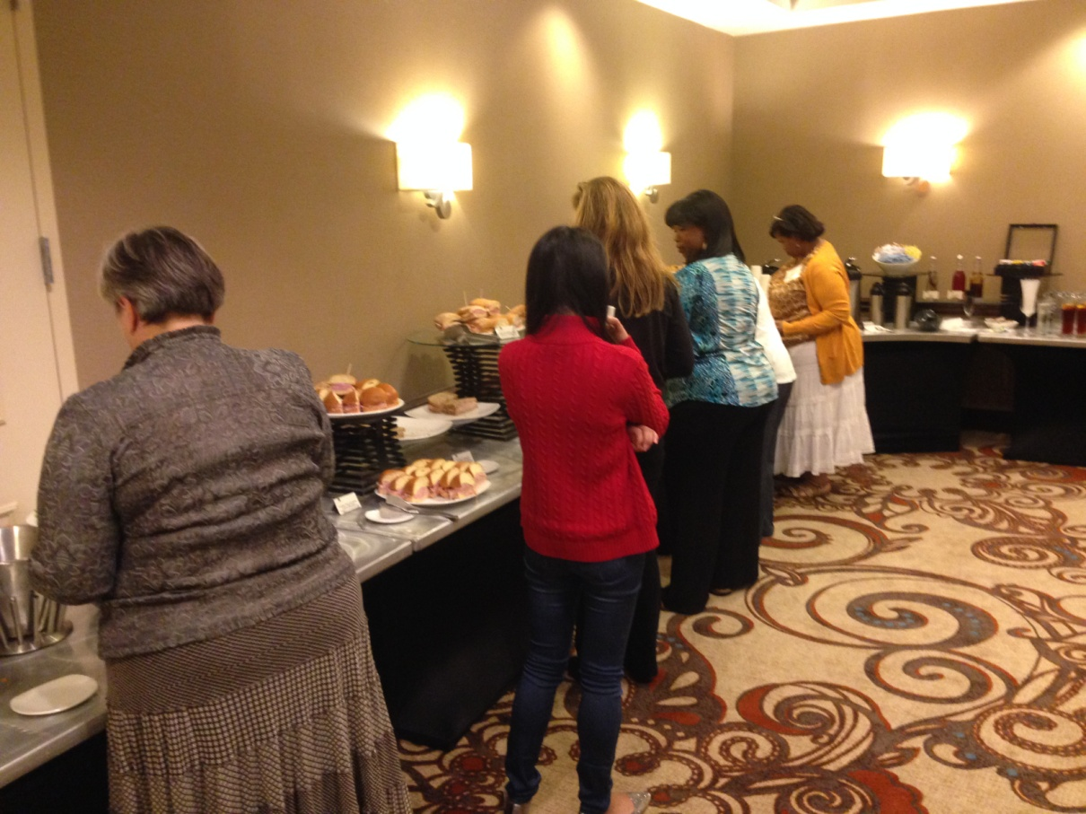
Before lunch mingling

Slide 23
Lunch networking

Slide 24
Everybody busy (nobody looks in the camera!)

Slide 26
ESSA

Slide 27
(Kendra or Garlfar continue on sessions, workshops, keynote speakers, ESSA, etc)

Slide 28
(Anthony starts on Capitol Hill)

Slide 29
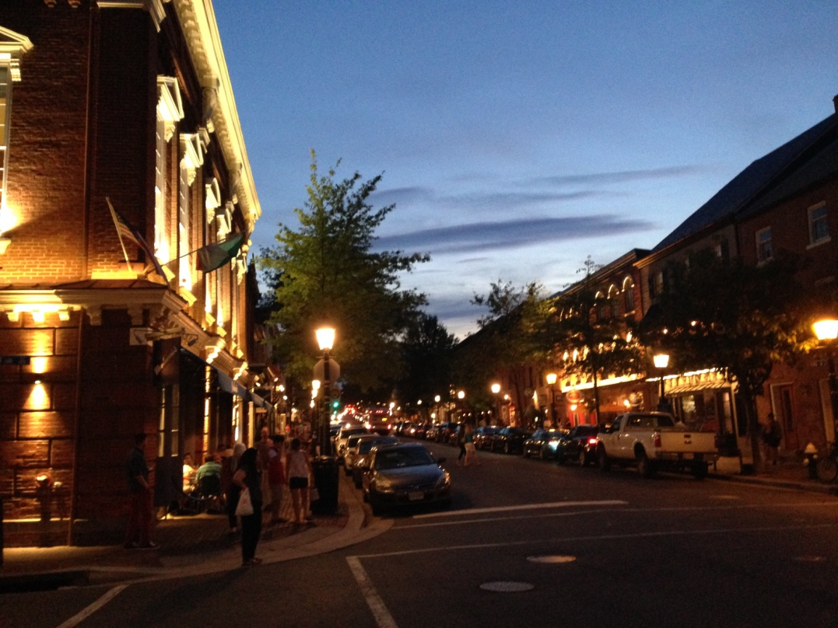
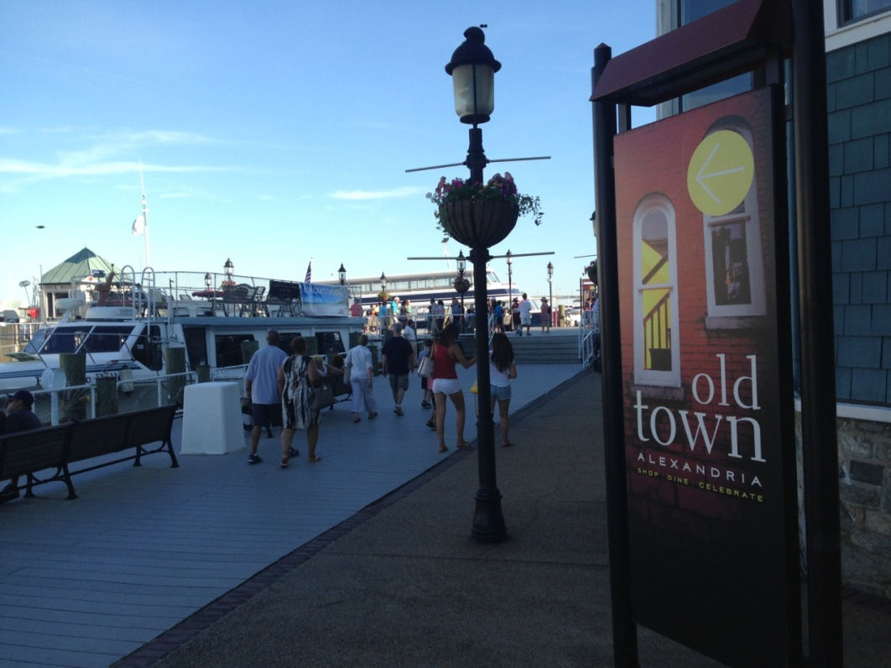
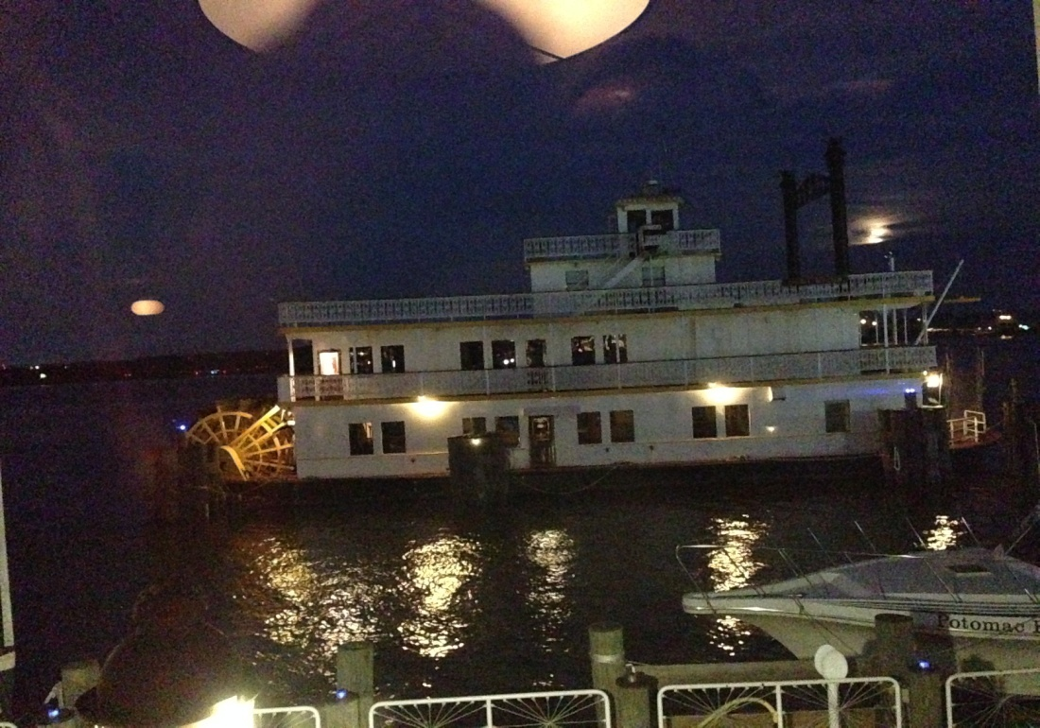
Alexandria, VA

Slide 30
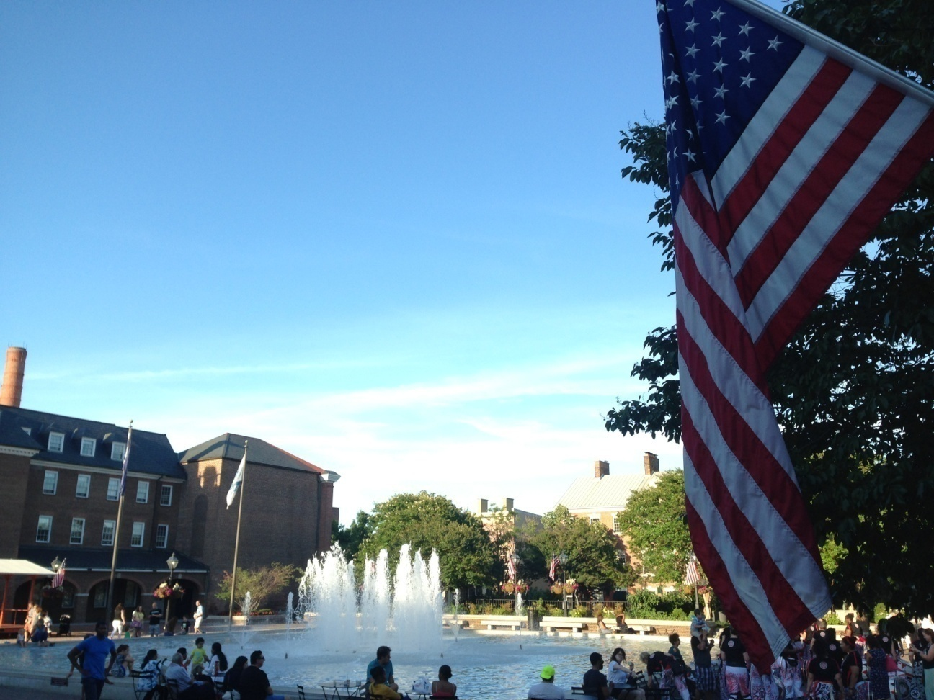

Slide 31
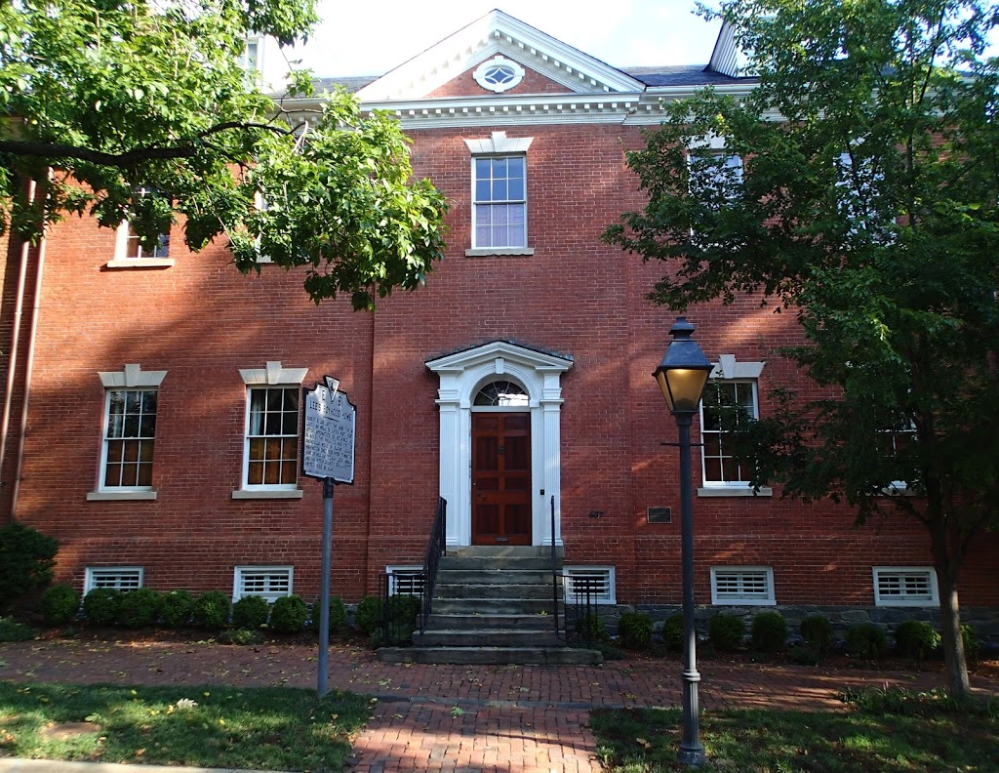

Slide 32
Tuesday – Capitol Hill trip
Extensive preparation
What to do and what not to do
How to be and how not to be (Hamlet?)
What to say and what not to say

Slide 33
DC subway system

Slide 34
King Street

Slide 35
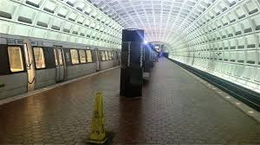
King St to Capitol Heights

Slide 37
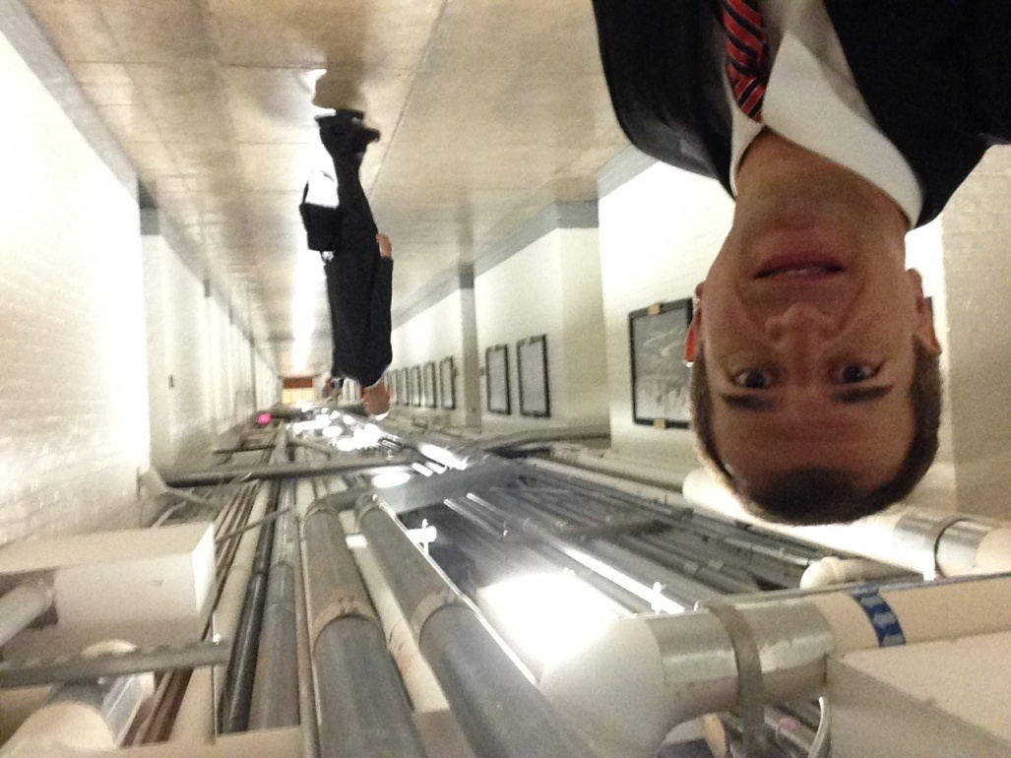

Slide 38
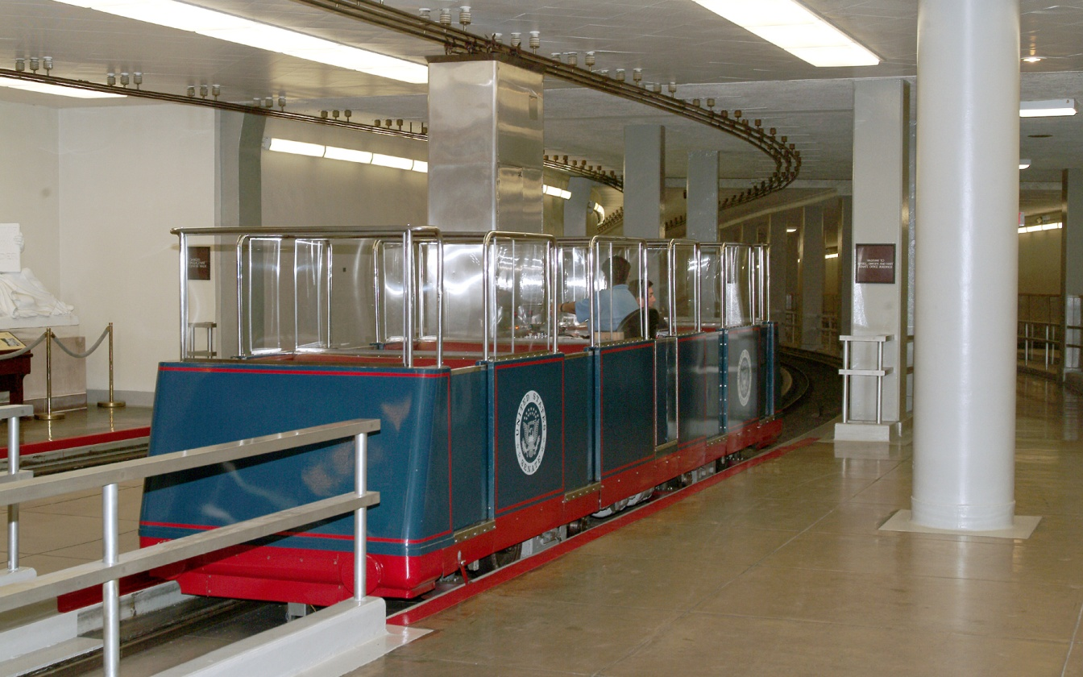
Train system

Slide 39
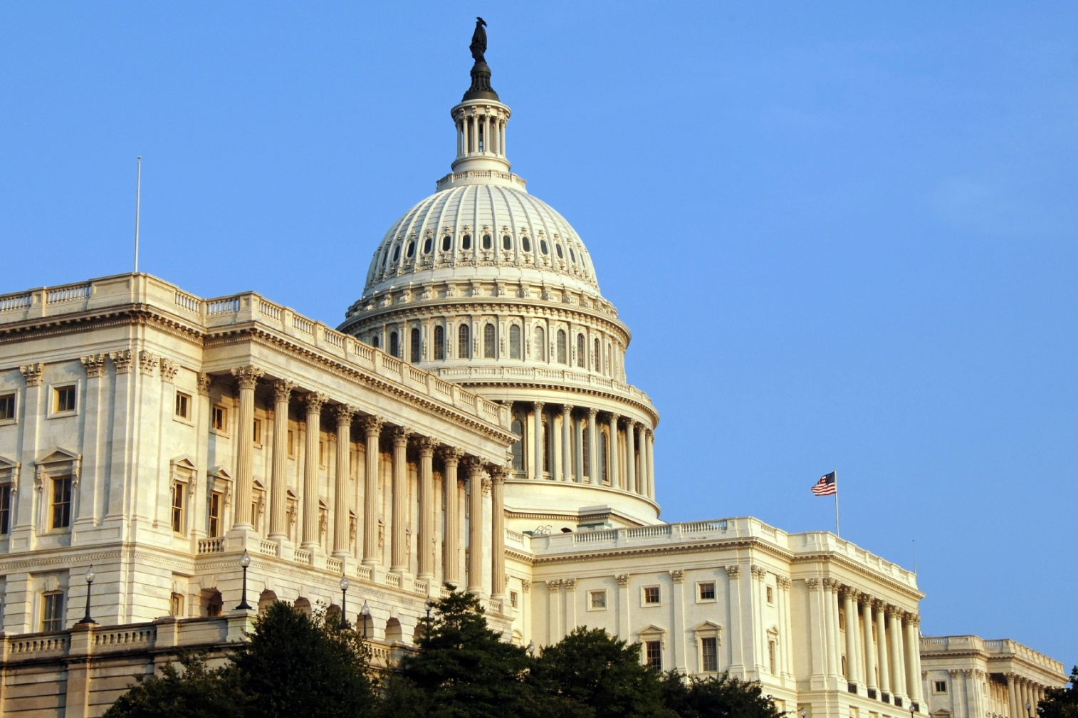
US House of Representatives

Slide 40
US Senate

Slide 42
Senator Johnny Isakson’s Office

Slide 43
Senator Johnny Isakson’s Office

Slide 44
Senator David Perdue’s office

Slide 45
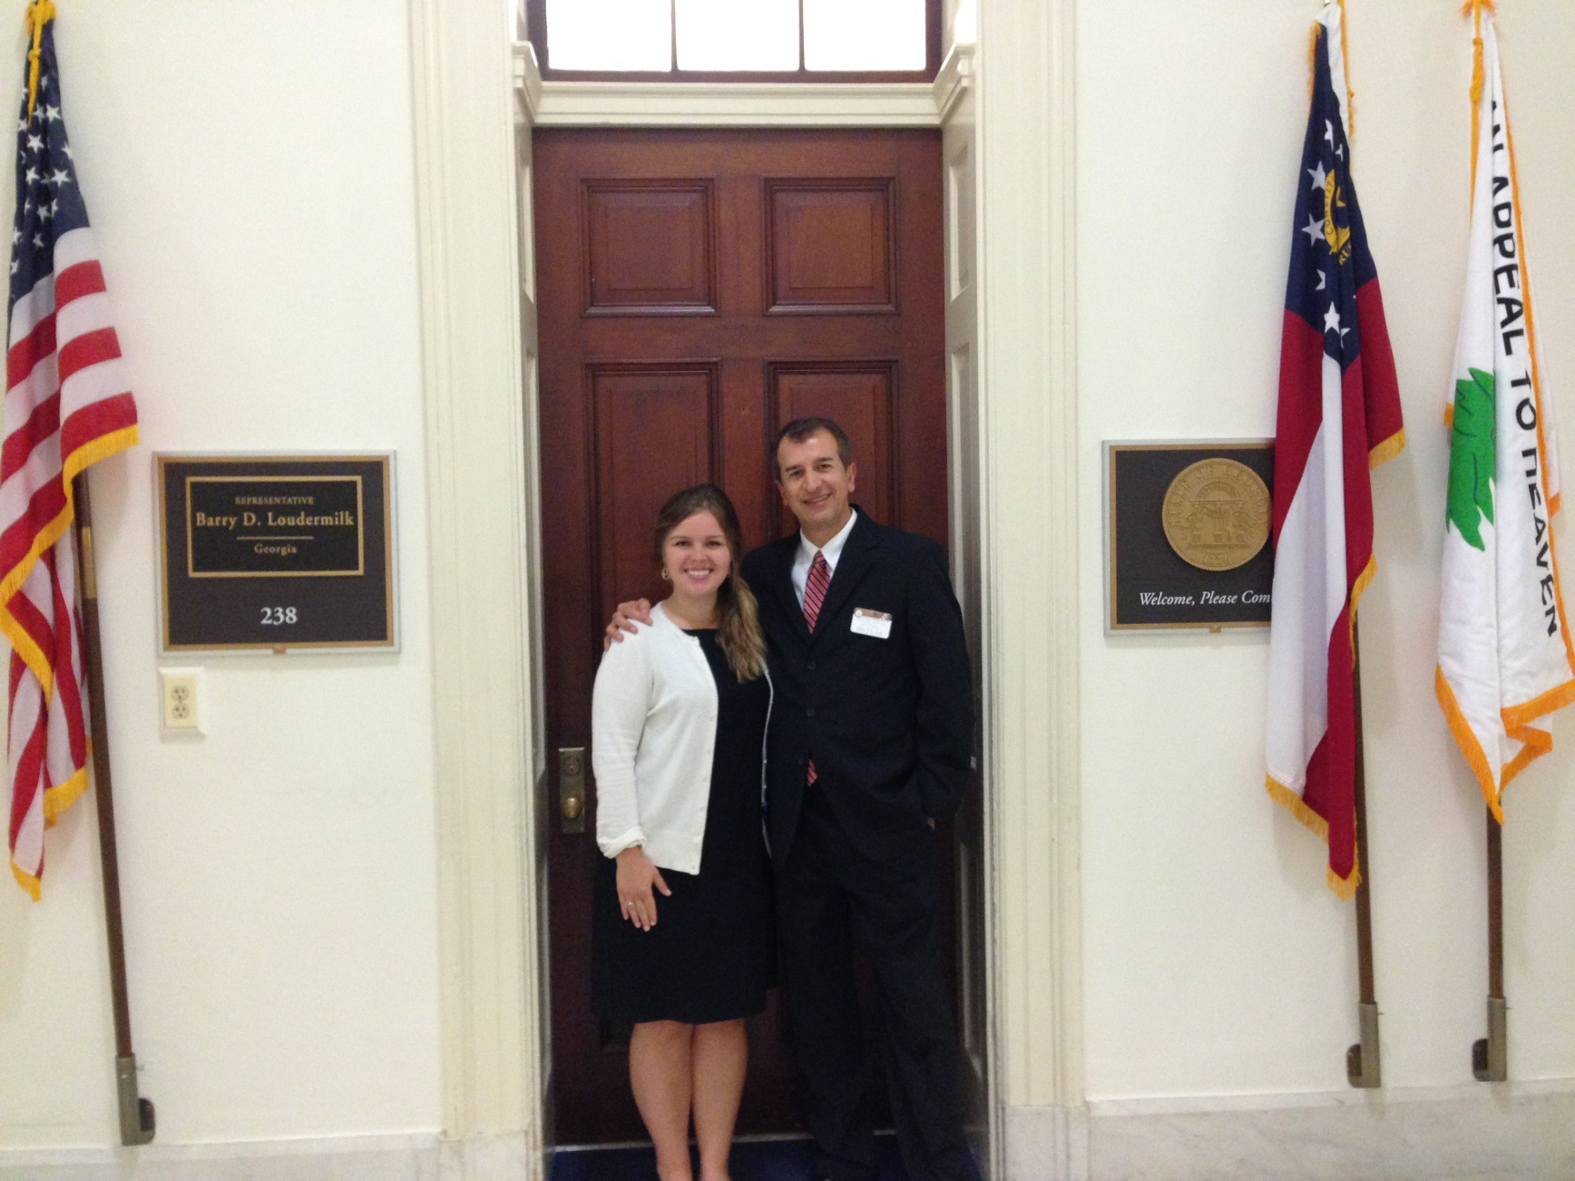
Representative Barry D. Loudermilk office

Slide 46
Team Texas

Slide 47
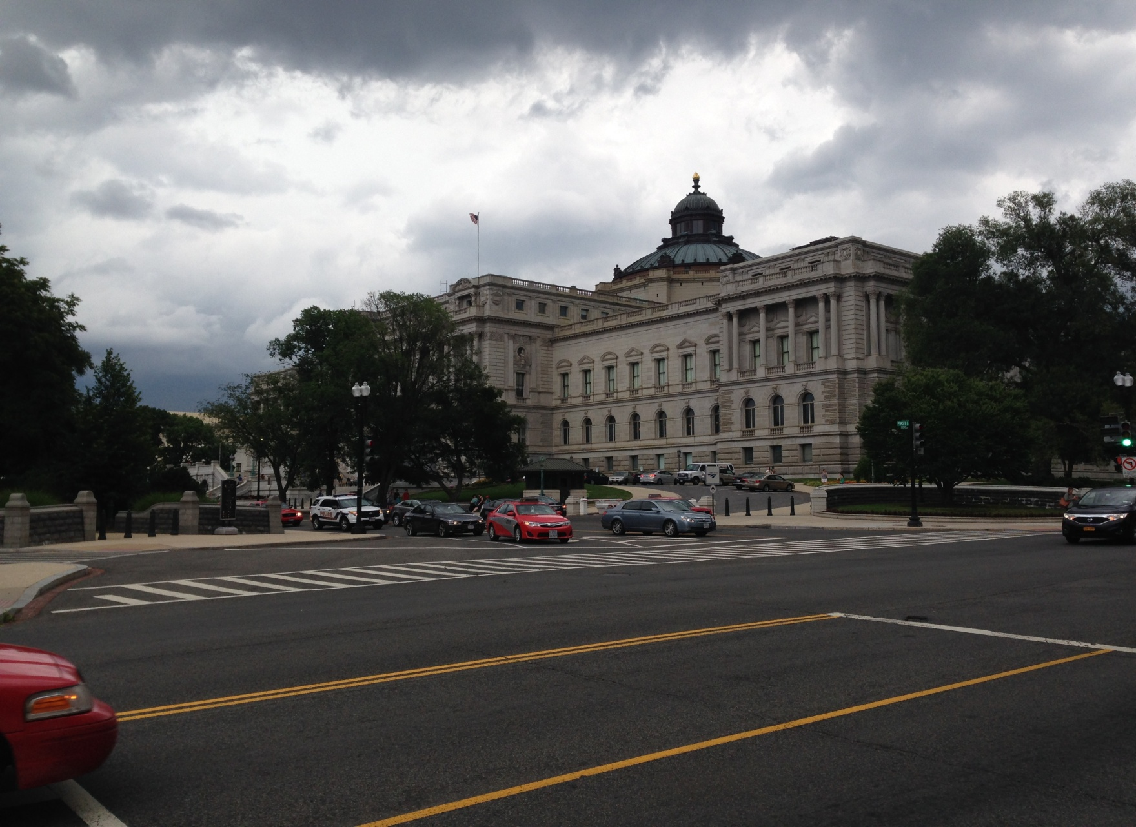
After 5 PM business
Library of Congress

Slide 48
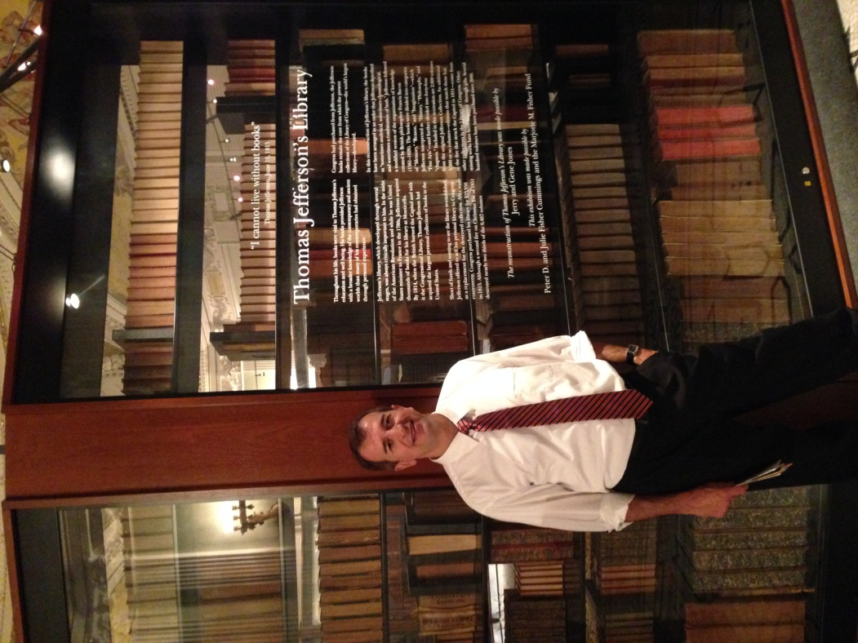

Slide 49
As a rain was approaching…

Slide 50
Results
Anthony: Senators’ staff members visited Global Initiative’s Committee meeting at Chattahoochee Technical College

Slide 51
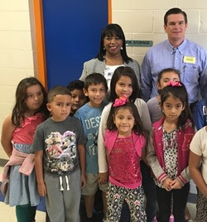
Results
Kendra: Congressman Austin Scott (8th District) visited ESOL Program (pictured with 2nd grade ESOL students)

Slide 52
Kendra’s Takeaway
“What I loved about this whole event was that it gave me the tools to be an advocate. It also highlighted viable community partners that are interested in similar issues.”

Slide 53
Five Steps to ELL Advocacy - NEA
1. Isolate the issue
2. Identify your allies
3. Be clear on the rights of ELL students
4. Organize and educate others
5. Identify your outlets for change
“How Educators Can Advocate for English Language Learners” March 2015

Slide 54
Results
Garlfar:

Slide 55
2016 TESOL Policy & Advocacy Summit: A Re-delivery
Kendra M. Castelow
Anthony Dahlen
Garlfar Andrews

