Slide 1
A Science and Geography Unit Encouraging Culturally-Relative Teaching
Act Locally, Think Globally, Read and Write Critically
With Your Host Kim Moore
GATESOL 2017

Slide 2
Four Motivational Conditions for Culturally-Responsive Teaching:
Establishing Inclusion
Developing Attitude
Enhancing Meaning
Engendering Competence
A Framework for Culturally-Responsive Teaching
By Raymond J. Wlodkowski and Margery B. Ginsberg
Notes:
Establishing inclusion —creating a learning atmosphere in which students and teachers feel respected by and connected to one another.
Developing attitude —creating a favorable disposition toward the learning experience through personal relevance and choice.
Enhancing meaning—creating challenging, thoughtful learning experiences that include student perspectives and values.
Engendering competence—creating an understanding that students are effective in learning something they value.
Culturally-responsive teaching needs to be included in every classroom, but often, regular classroom teachers must be reminded by ESOL teachers why all students need to acknowledge and learn about a variety of different cultures. Culturally Responsive Teaching is a pedagogy that recognizes the importance of including students' cultural references in all aspects of learning (Ladson-Billings,1994).

Slide 3
Create a BioPoem
Line 1: First Name.
Line 2: Three of four adjectives that describe a person.
Line 3: Important relationship (son of…).
Line 4: Who believes in (something the person believes in).
Line 5: Who feels (describe feelings the person experiences).
Line 6: Who fears (Describe fears the person experiences).
Line 7: Who wants (Describe something that the person wants to see happen or wants to experience).
Line 8: Last name.
A biopoem describes a character or a person. It uses carefully chosen words or short phrases to describe important characteristics of a person.
Notes:
BioPoem
Purposes—1) help you to know more about your students 2) part of speech 3) critical thinking

Slide 4
Create a BioPoem
Kim.
Loyal, dedicated, loving, and intuitive.
Wife of Daniel.
Who believes in making a different in a harsh world.
Who feels overwhelmed by evil acts.
Who fears destruction of lives and our environment.
Who wants a life worth living for my children and future generations.
Moore.
How do you think a Biopoem that you write about yourself might differ from one written by someone else who knows you? By comparing and contrasting how these poems are alike or different, what can you learn about yourself?

Slide 5
“The key to culturally relevant teaching is teachers creating meaningful
and engaging connections
between students' home and
school lives. Teachers who learn
about students' culture are able
to make purposeful connections to the curriculum.”
Megan Adams, Sanjuana Rodriguez, and Kate Zimmer , Professors at Kennesaw State University during an EdWeek Teacher interview
about their book, Culturally Relevant Teaching: Preparing
Teachers To Include All Learners, October 4, 2017.
Notes:
Culturally-Relevant teaching takes culturally-responsive teaching to a new level. With culturally-responsive teaching you are purposely weaving a story within your curriculum units that includes information that connects a variety of cultures, including diverse literature and informational text, to the classroom and community. We are going to explore this type of unit today.

Slide 6
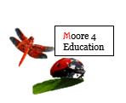
“By forging visual, cultural, and geographical connections, a teacher can help to create a bridge between old and new experiences for their students. Building this type of background knowledge regarding content found in the science and social studies standards can accelerated students’ learning significantly. Furthermore, when you also involve the students’ family and the community in these experiences, students feel relevant and are highly motivated to learn the new information.”
Kim Moore
Notes:
My Hypothesis—creating activism where the students become emotionally involved in the learning makes for motivational and memorable experiences. Real world….

Slide 7
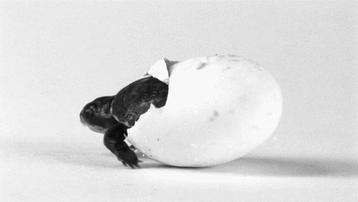
Global Efforts on Behalf of the Loggerhead Turtle

Slide 8
Generalization of Strategies:
Building Background Knowledge Through Visualization
Creating Thinking Strategies for Improving Comprehension
Understanding Tier 2 and 3 Vocabulary to Promote Inquiry
Using Disciplinary Literacy to Meet the Standards

Slide 9
Discover Your Students’ Interests
I like to spend as much time outdoors as possible.
If given a choice, I prefer to be inside rather than outside.
There are several outdoor activities--fishing, hiking, water-skiing, and others--that I enjoy doing.
I associate the outdoors with discomfort: bugs, dirt, unpredictable weather.
I help my family and/ or my school in recycling efforts.
I enjoy identifying different kinds of plants and animals.
I am knowledgeable and concerned about environmental issues.
pollev.com/kimmoore527

Slide 10
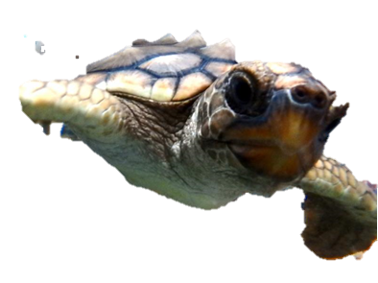
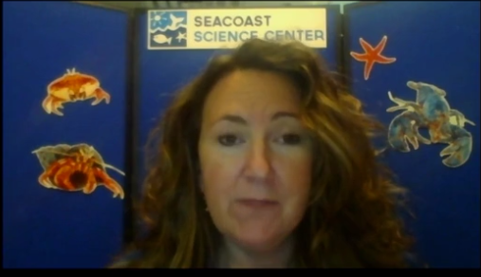
Building Background Knowledge Through Visualization
Live Streaming Events….www.fieldtripzoom.com
Notes:
Visualization
Concrete to “in your minds eye”
In Slideshow mode: Click
Free for all Georgia teachers until the end of the year! Register using your school email address. The FieldTripZoom Zone calendar is a collection of prescheduled live streaming events that will help you motivate and inspire your students throughout the academic year. Simply sign up and register for the event and stream them right in the classroom. Our content partners have designed programs specifically to accommodate the FieldTripZoom Zone live streaming format. While presentation formats will vary, each event runs 30 to 45 minutes and includes question and answer time. It’s all live and interactive!

Slide 11
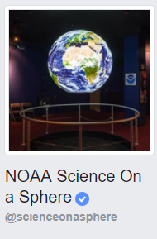
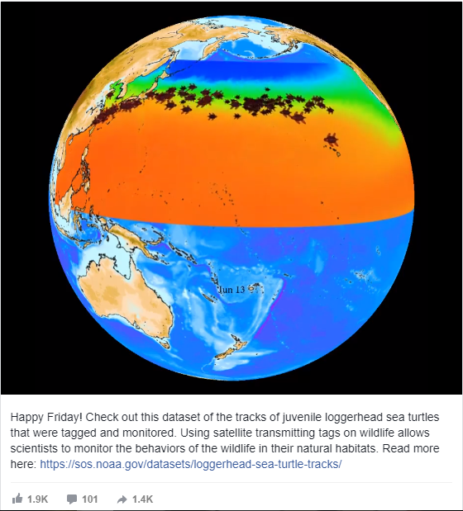
Global Efforts on Behalf of the Loggerhead Turtle
Notes:
In Slideshow mode: Click sphere to see migration….click NOAA Science on Sphere to see spheres on a variety of topics

Slide 12
from Saving Our Sea Turtles
After the Oil Spill in the Gulf of Mexico, Their Fate is in Our Hands
By Elizabeth Preston
Research Article
“…Each turtle got two baths. Turtle washers used Dawn soap and toothbrushes to scrub oil out of the folds of the turtle’s skin, and cotton swabs to remove oil from their throats. A wipe-down using mayonnaise (believe it or not), helped to strip off the sticky oil.”
Notes:
In Slideshow mode: Click on Connections cover to read research article

Slide 13
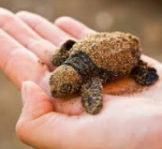
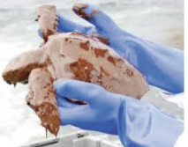
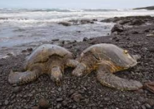
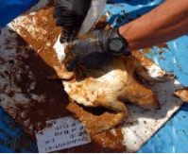
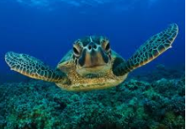
Notes:
In Slideshow mode: Click on sound and first picture to go through a variety of pictures of turtles…..

Slide 14
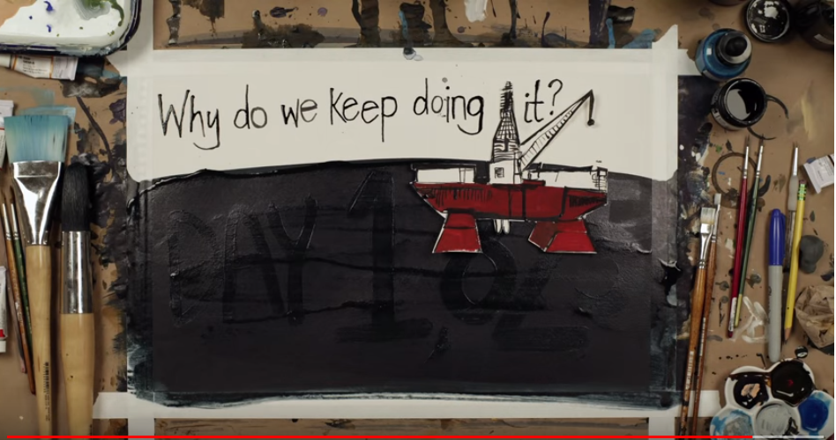
Notes:
OER—The Kids Should See This website
Video about oil spills

Slide 15
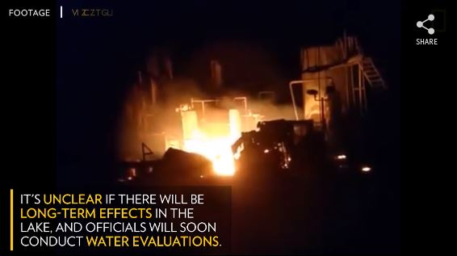
Explosion on Lake Ponchartrain in LA October 2017
Notes:
Recently in the news….

Slide 16
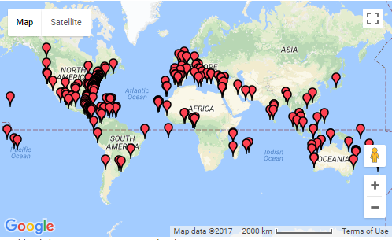
Map of the Loggerhead Turtle Research and Conservation Centers
forging visual, cultural, and geographical connections
Notes:
Click to go to actual map online
Orange rectangle denotes migration patterns of the Loggerhead turtles

Slide 17
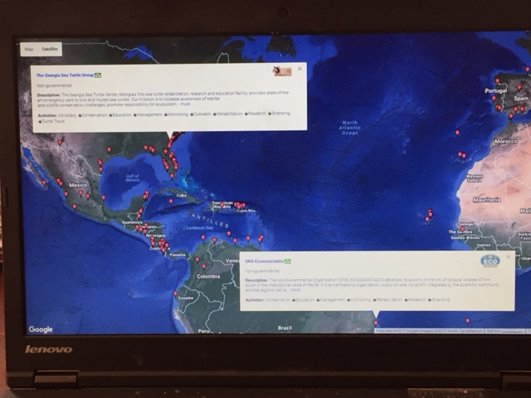
The Georgia Sea Turtle Group
The Georgia Sea Turtle Group
ONG Ecoassociados
Notes:
Satellite image. Shows topography. Think about the country of origin of your students. You can have the students group this way, and you can give those who do not have anyone from their origin country either work alone or join another group. This is a geographical representation of sea turtle groups in Georgia (The Georgia Sea Turtle Group) and Brazil (ONG Ecoassociados). On the internet. They can conduct research in English and/ or their native language. There are many ways that groups can share their results with the class:
--Write a play
--sing a song

Slide 18
The Georgia Sea Turtle Group
Georgia, USA | Brazil, South American
Write/ perform a play
Write/ sing a song or poem
PowerPoint Presentation
Interview someone from organizations
Write a compare and contrast essay.
Notes:
Satellite image. Shows topography. Think about the country of origin of your students. You can have the students group this way, and you can give those who do not have anyone from their origin country either work alone or join another group. This is a geographical representation of sea turtle groups in Georgia (The Georgia Sea Turtle Group) and Brazil (ONG Ecoassociados). On the internet. They can conduct research in English and/ or their native language. There are many ways that groups can share their results with the class:
Write/ perform a play
Write/ sing a song or poem
PowerPoint Presentation
Interview someone from organizations
Write a compare and contrast essay.

Slide 19
Making a Difference :
Family and Community Involvement
WIDA Standards “David Meets Goliath at City Hall”
Standard 1 English language learners communicate for Social and Instructional Purposes within the school setting (listening, speaking, reading)
Standard 2 English language learners communicate information, ideas, and concepts necessary for academic success in ELA (listening, speaking, reading)
Standard 4 English language learners communicate information, ideas, and concepts necessary for
academic success in Science (listening, speaking)
Notes:
Click on Top Cover to learn more about Literature and Thought
Click on Bottom cover to see sample copy of Literature and Thought “Ecology” TG/ SE

Slide 20
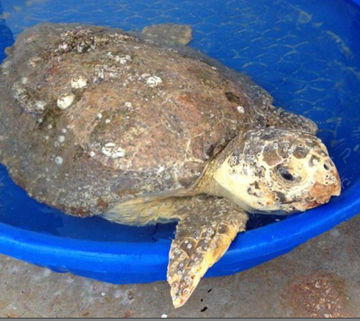
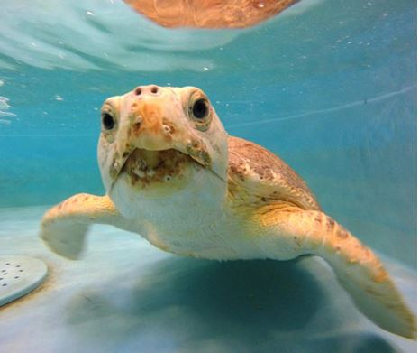
Adopt-a-Turtle
Coral
Notes:
Click on Adoptive Parent to learn how to adopt a turtle from Georgia Sea Turtle Center

Slide 21
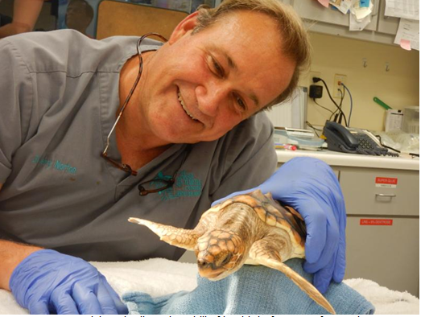
Adopt-a-Turtle
Charlie
Emails

Slide 22
Kim Moore
E-Mail: kmoore@perfectionlearning.com
Twitter: twitter.com/moore4STEMed
Mobile: 678-323-5500
Linked In: www.linkedin.com/in/moore4education/

